Slide 1


Electric Circuits
Twelfth Edition, Global Edition
Chapter 7 – Part 3
Response of First-Order RL and RC Circuits
© 2024 Pearson Education Ltd. All Rights Reserved.
Notes:
If this PowerPoint presentation contains mathematical equations, you may need to check that your computer has the following installed:
1) Math Type Plugin
2) Math Player (free versions available)
3) NVDA Reader (free versions available)

Slide 2

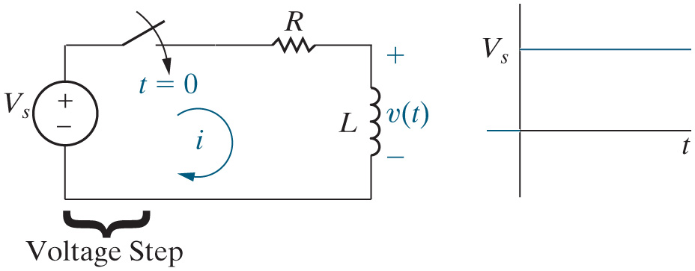

Chapter 7 – R L Step Response (1 of 10)
The problem: Given an initial current i(0) through L at t = 0, find i(t)
for
Note that the initial current may be 0!
This is the step response of this circuit because for
there is
an independent source in the circuit – the response is due to the initial energy stored in the inductor as well as the energy supplied
by the voltage source for

Slide 3

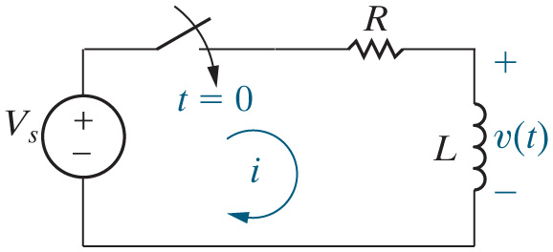
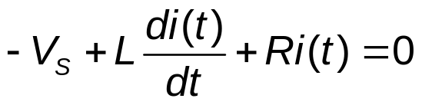
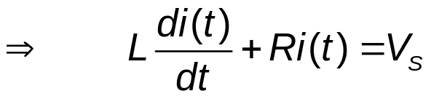
Chapter 7 – R L Step Response (2 of 10)
K V L for
This equation is a
First-order (the highest derivative is a first derivative)
Inhomogeneous (the right-hand side is non-zero)
Ordinary differential equation
With constant coefficients
The left-hand side of the equation is identical to the describing differential equation for the R L Natural Response!

Slide 4

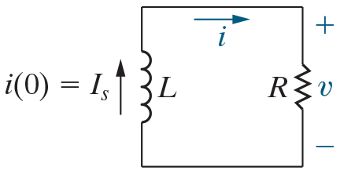




Chapter 7 – R L Step Response (3 of 10)
The circuit we analyzed for the R L natural response problem is
shown below, along with the expression for i(t), for
What is
the value of i(t) as
A. 0
B.
C.

Slide 5


Chapter 7 – R L Step Response (3 of 10)
The circuit we analyzed for the R L natural response problem is
shown below, along with the expression for i(t), for
What is
the value of i(t) as
A. 0
B.
C.

Slide 6



Chapter 7 – R L Step Response (4 of 10)
Now consider what happens to the current as
in the R L
step response circuit. First, as
we can replace the inductor
by
A. An open circuit
B. A short circuit
C. A resistor

Slide 7
Chapter 7 – R L Step Response (4 of 10)
Now consider what happens to the current as
in the R L
step response circuit. First, as
we can replace the inductor
by
A. An open circuit
B. A short circuit
C. A resistor

Slide 8

Chapter 7 – R L Step Response (5 of 10)
To evaluate the current in the inductor as
close the switch
and replace the inductor with a short circuit. The current in the short circuit is
A. 0
B. infinite
C.

Slide 9
Chapter 7 – R L Step Response (5 of 10)
To evaluate the current in the inductor as
close the switch
and replace the inductor with a short circuit. The current in the short circuit is
A. 0
B. infinite
C.

Slide 10
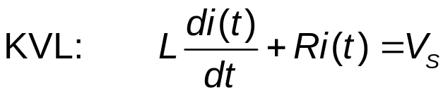









Chapter 7 – R L Step Response (6 of 10)
The functional form for i(t) should be the same as for the natural response!
Try
where
is the initial inductor current.
But as
which is incorrect!
Try
where
is the inductor current as
Then
(OK)
But
(NO!)

Slide 11
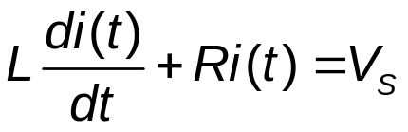



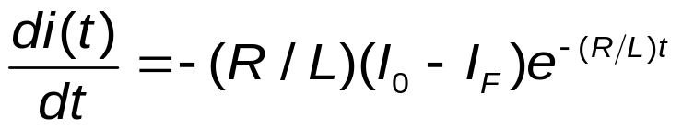
Chapter 7 – R L Step Response (7 of 10)
K V L:
Now try
Then
(OK)
And
(OK)
Make sure that this i(t) satisfies the differential equation:
Substituting,
Notes:
Long Description 1:
i (0) equals I subscript F baseline plus Open Parenthesis I subscript 0 baseline minus I subscript F Close Parenthesis e to the negative Open Parenthesis R divided by L Close Parenthesis (0) power equals I subscript F baseline plus I subscript 0 baseline minus I subscript F baseline equals I subscript 0.
Long Description 2:
L open square bracket negative (R divided by L ) Open Parenthesis I subscript 0 baseline minus I subscript F Close Parenthesis e to the negative Open Parenthesis R divided by L Close Parenthesis t power close square bracket plus R open square bracket I subscript F baseline plus Open Parenthesis I subscript 0 baseline minus I subscript F baseline Close Parenthesis e to the negative Open Parenthesis R divided by L Close Parenthesis t power close square bracket equals R I subscript F baseline equals V subscript S.

Slide 12
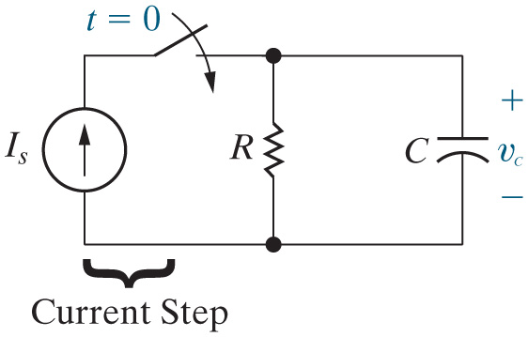






Chapter 7 – R L Step Response (8 of 10)
The problem: Given an initial voltage drop v(0) across C at
find v(t) for
Note that the initial voltage may be 0!
This is the duel of the R L step response problem, so its solution is the duel of the solution to the R L step response!
where
and

Slide 13

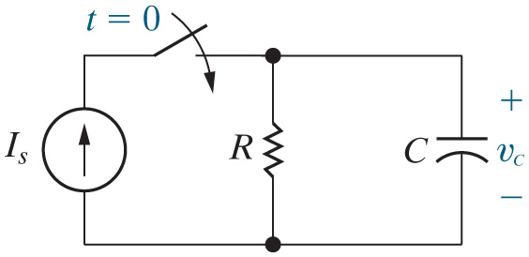
Chapter 7 – R L Step Response (9 of 10)
Here is the circuit for the R C step response problem.
As
the capacitor can be replaced by
A. An open circuit
B. A short circuit
C. A constant current

Slide 14
Chapter 7 – R L Step Response (9 of 10)
Here is the circuit for the R C step response problem.
As
the capacitor can be replaced by
A. An open circuit
B. A short circuit
C. A constant current

Slide 15

Chapter 7 – R L Step Response (10 of 10)
To evaluate the voltage drop across the capacitor as
close the switch and replace the capacitor with an open circuit. The voltage drop across the open circuit, positive at the top, is
A. 0
B.
C. infinite

Slide 16
Chapter 7 – R L Step Response (10 of 10)
To evaluate the voltage drop across the capacitor as
close the switch and replace the capacitor with an open circuit. The voltage drop across the open circuit, positive at the top, is
A. 0
B.
C. infinite

Slide 17









Chapter 7 – R L/R C Step Response
A general solution method:
Step 1 – Identify the variable x(t), which is the inductor current for RL circuits and capacitor voltage for R C circuits.
Step 2 – Calculate the initial value
by analyzing the circuit to find x(t)
for
Step 3 – Calculate the time constant
for R L circuits,
and for R C circuits,
where R is the equivalent resistance
connected to the inductor or capacitor for
Step 4 – Calculate the final value
by analyzing the circuit to find x(t)
as
Step 5 – Write the equation for x(t),
for
Step 6 – Calculate other quantities of interest using x(t).

Slide 18
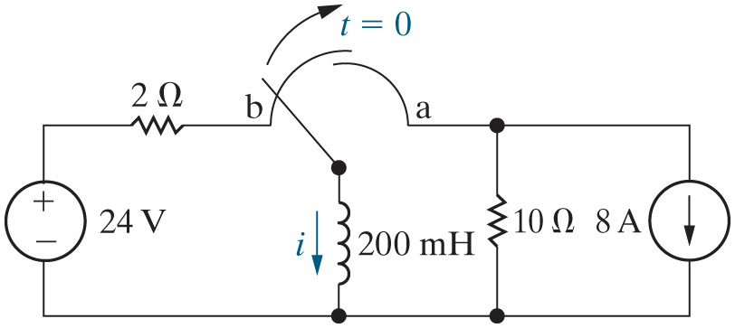


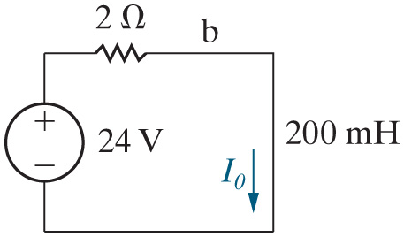

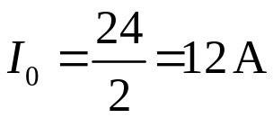
Chapter 7 – R L/R C Step Response Examples (1 of 10)
Find i(t) for
Step 1 – Identify the variable x(t), which is the inductor current labeled i in the circuit.
Step 2 – Calculate the initial value
by analyzing the circuit to
find i(t) for
For

Slide 19

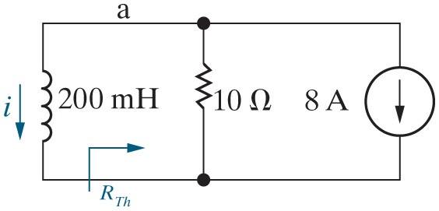



Chapter 7 – R L/R C Step Response Examples (2 of 10)
Step 3 – Calculate the time constant,
for
What is the Thevenin equivalent resistance of the circuit attached to the inductor?
A.
B.
C.

Slide 20
Chapter 7 – R L/R C Step Response Examples (2 of 10)
Step 3 – Calculate the time constant,
for
What is the Thevenin equivalent resistance of the circuit attached to the inductor?
A.
B.
C.

Slide 21




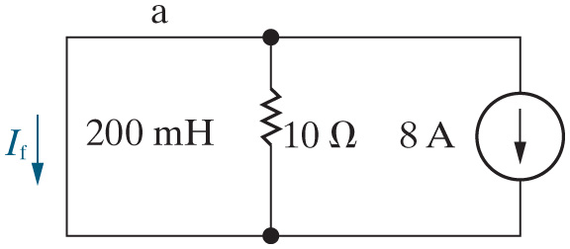

Chapter 7 – R L/R C Step Response Examples (3 of 10)
Find i(t) for
(continued).
The time constant is
Step 4 – Calculate the final value
by analyzing the circuit to find
i(t) as
As

Slide 22




Chapter 7 – R L/R C Step Response Examples (4 of 10)
Find i(t) for
(continued).
Step 5 – Write the expression for the inductor current:
Check:
(OK)
(OK)

Slide 23





Chapter 7 – R L/R C Step Response Examples (5 of 10)
Find the current in the resistor (flowing from top to bottom),
given the inductor current just calculated, for
A.
B.
C.

Slide 24
Chapter 7 – R L/R C Step Response Examples (5 of 10)
Find the current in the resistor (flowing from top to bottom),
given the inductor current just calculated, for
A.
B.
C.

Slide 25





Chapter 7 – R L/R C Step Response Examples (6 of 10)
Find the voltage drop across the resistor (positive at the top),
given the resistor current just calculated, for
A.
B.
C.

Slide 26
Chapter 7 – R L/R C Step Response Examples (6 of 10)
Find the voltage drop across the resistor (positive at the top),
given the resistor current just calculated, for
A.
B.
C.

Slide 27
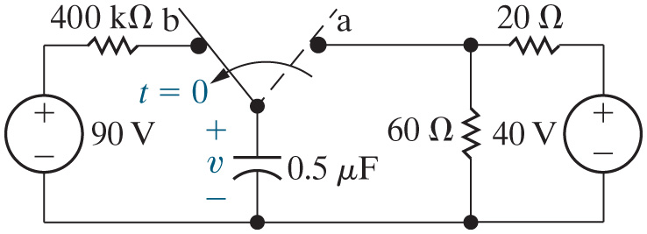

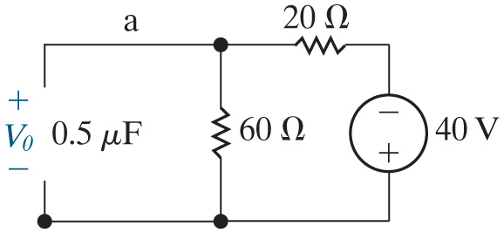

Chapter 7 – R L/R C Step Response Examples (7 of 10)
Find v(t) for
Step 1 – The variable x(t) is the capacitor voltage drop, which is already defined in the circuit.
Step 2 – Calculate the initial value of the voltage drop across the
capacitor,
For

Slide 28

Chapter 7 – R L/R C Step Response Examples (8 of 10)
What is the best circuit analysis tool to use when finding the initial voltage drop across the capacitor?
For
A. Current division
B. Voltage division
C. Source transform

Slide 29
Chapter 7 – R L/R C Step Response Examples (8 of 10)
What is the best circuit analysis tool to use when finding the initial voltage drop across the capacitor?
For
A. Current division
B. Voltage division
C. Source transform

Slide 30




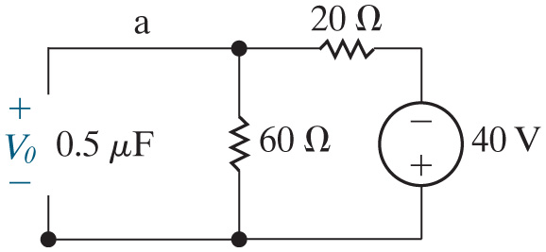
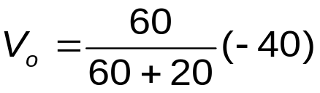


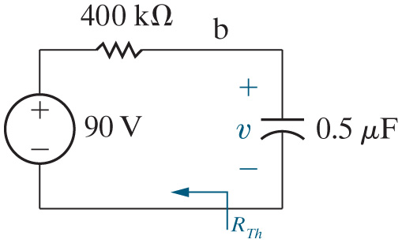

Chapter 7 – R L/R C Step Response Examples (9 of 10)
Find v(t) for
(continued).
Step 2 – Calculate the initial value of the voltage drop across the capacitor,
For
Step 3 – Calculate the time constant
For

Slide 31



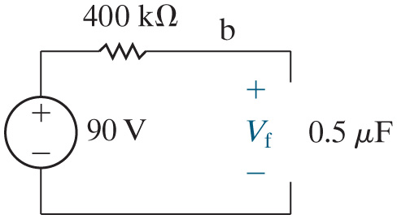

Chapter 7 – R L/R C Step Response Examples (10 of 10)
Find v(t) for
(continued).
Step 4 – Calculate the final value
As
Step 5 – Write the equation for v(t).
Notes:
Long Description:
v (t) equals V subscript f baseline plus Open Parenthesis V subscript 0 baseline minus V subscript f baseline Close Parenthesis e to the negative t divided by tau power equals 90 plus open square bracket negative 30 minus 90 close square bracket e to the negative t divided by 0.2 power.

Slide 32









Chapter 7 – R L/R C Natural and Step Response (1 of 2)
This is a general solution method for both the natural and step responses of first-order circuits. A circuit exhibiting a natural response has no independent source
as
so its final value
Step 1 – Identify the variable x(t), which is the inductor current for R L circuits and capacitor voltage for R C circuits.
Step 2 – Calculate the initial value
by analyzing the circuit to find x(t) for
Step 3 – Calculate the time constant
for R L circuits,
and for R C
circuits,
where R is the equivalent resistance connected to the inductor
or capacitor for
Step 4 – Calculate the final value
by analyzing the circuit to find x(t) as

Slide 33


Chapter 7 – R L/R C Natural and Step Response (2 of 2)
Step 5 – Write the equation for x(t),
for
Step 6 – Calculate other quantities of interest using x(t).

Slide 34

Copyright
This work is protected by United Kingdom copyright laws and is provided solely for the use of instructors in teaching their courses and assessing student learning. Dissemination or sale of any part of this work (including on the World Wide Web) will destroy the integrity of the work and is not permitted. The work and materials from it should never be made available to students except by instructors using the accompanying text in their classes. All recipients of this work are expected to abide by these restrictions and to honor the intended pedagogical purposes and the needs of other instructors who rely on these materials.

